Slide 1


Careforyou
HANDOVER PACKAGE PRESENTATION
Santosh Reddy
Abhinav Kapoor
Zhenyu Liu
Haoqi Xu

Slide 2
Contents
Project Overview
Handover Package Timeline
Creation of Support Document
Support Document Timeline
Creation of Maintenance Document
Maintenance Document Timeline
Creation of Product Document
Product Document Timeline
Conclusion

Slide 3
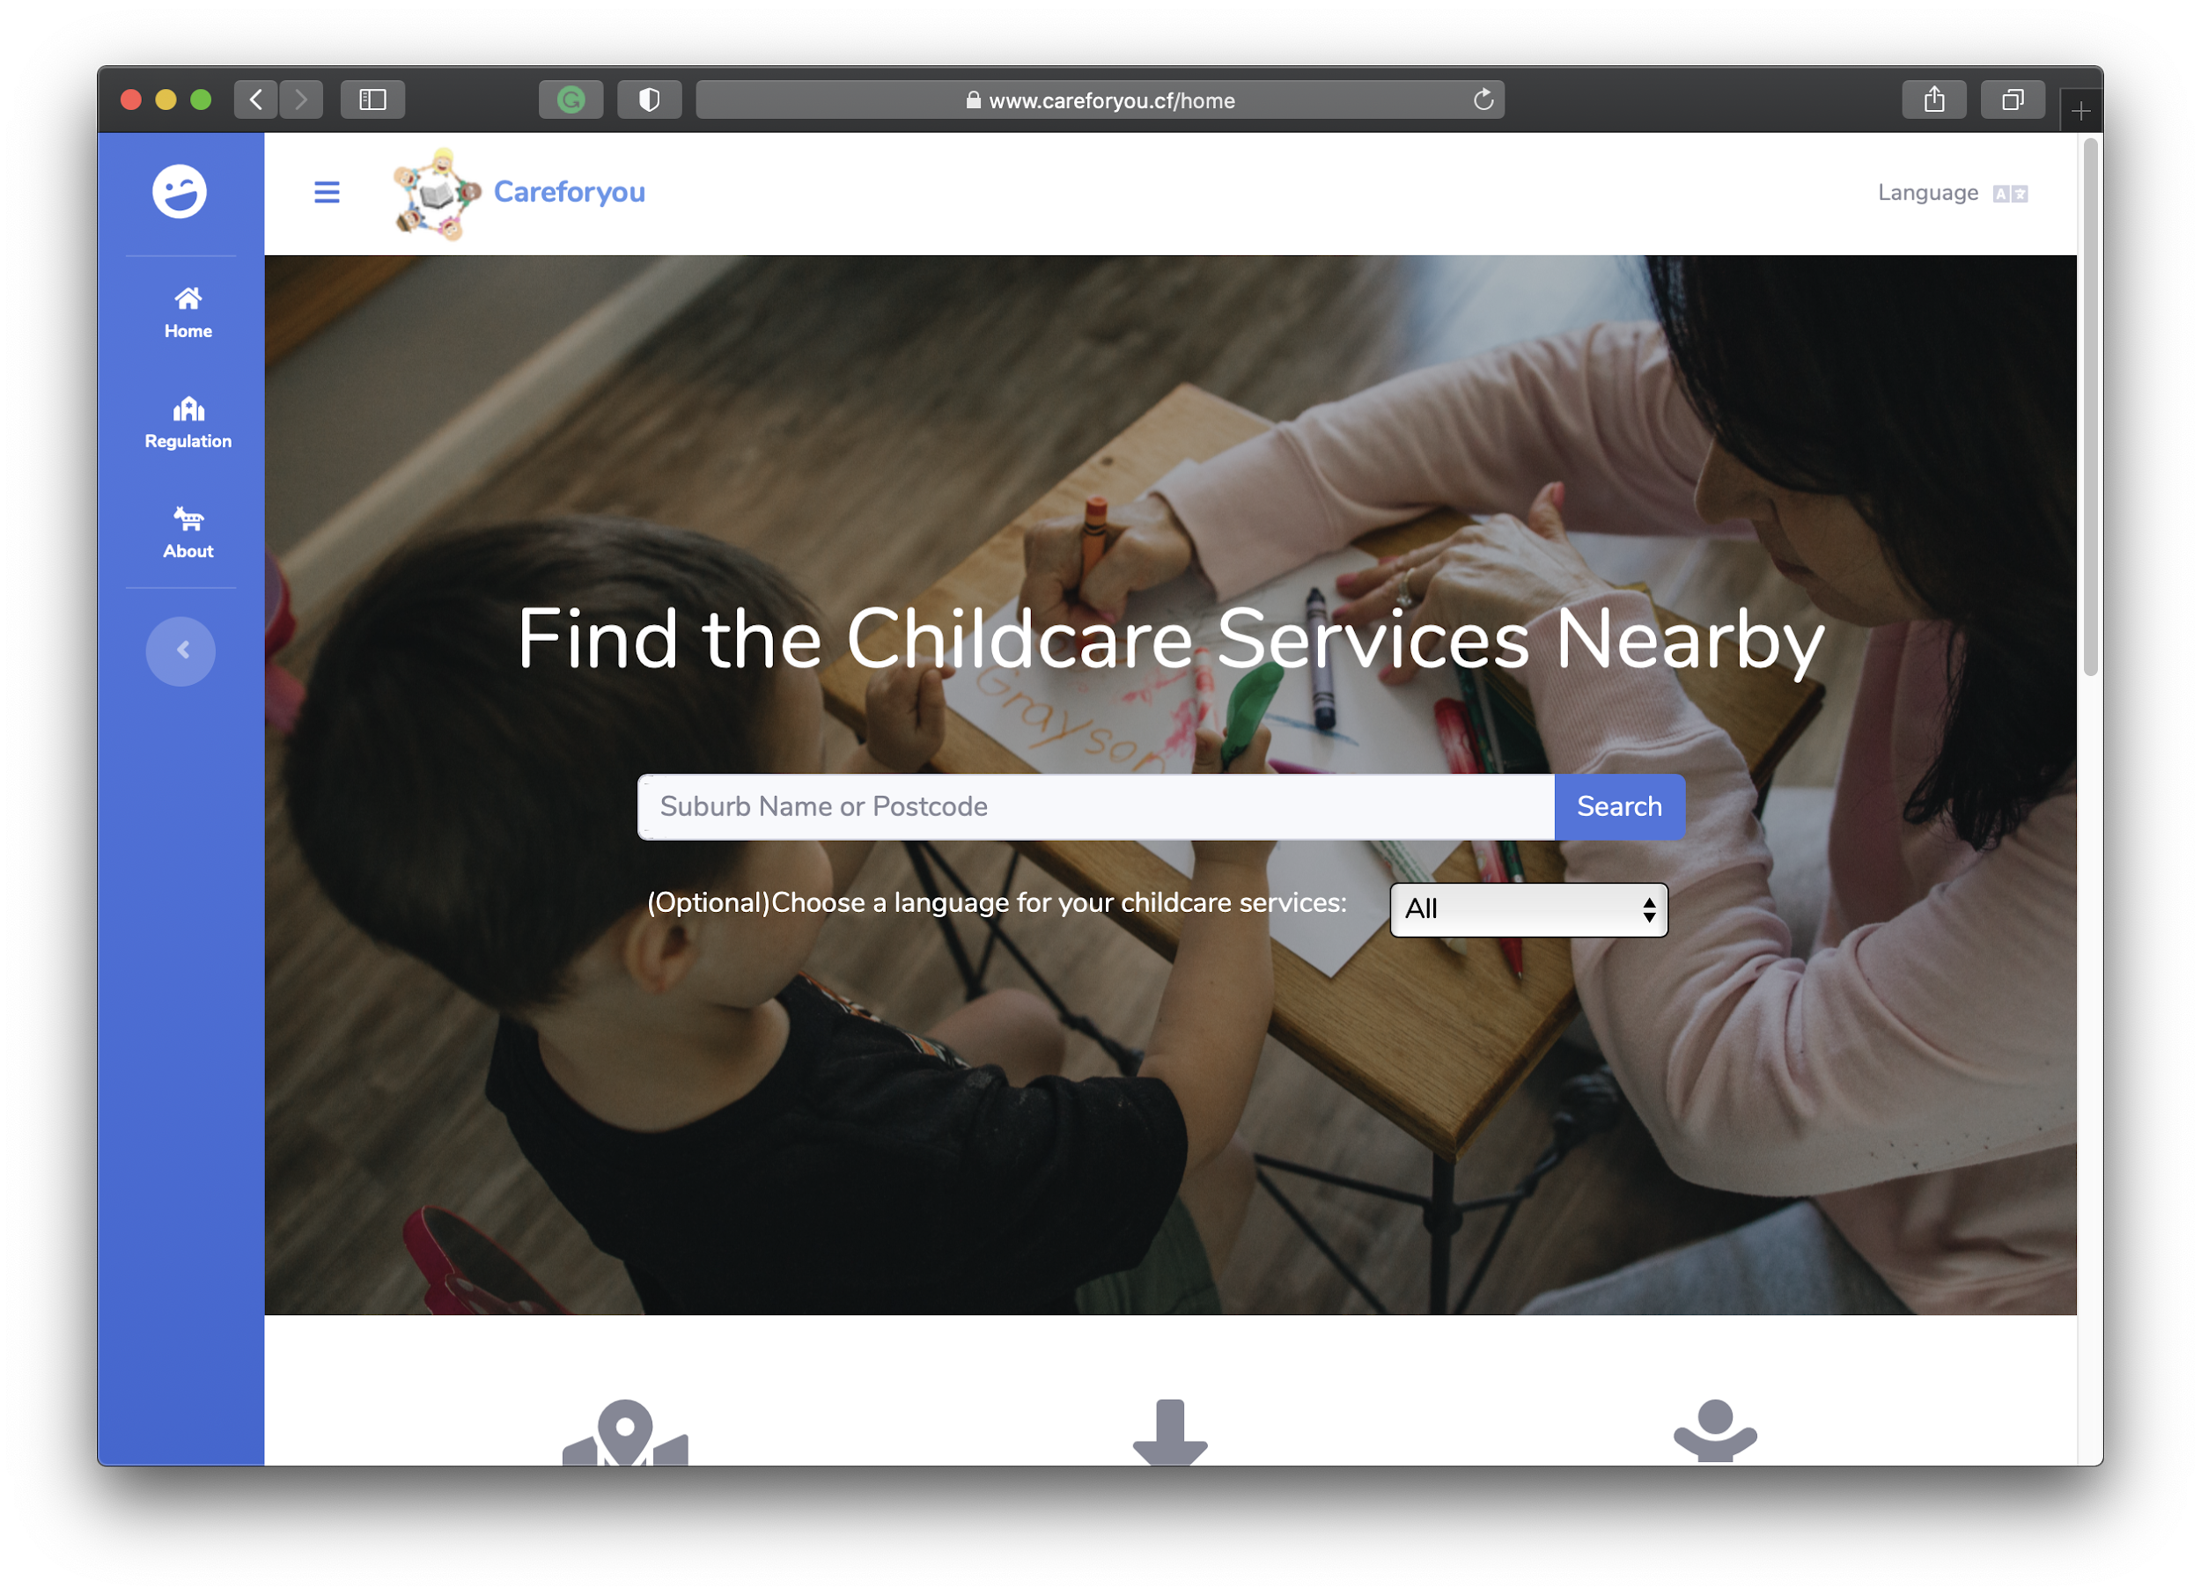
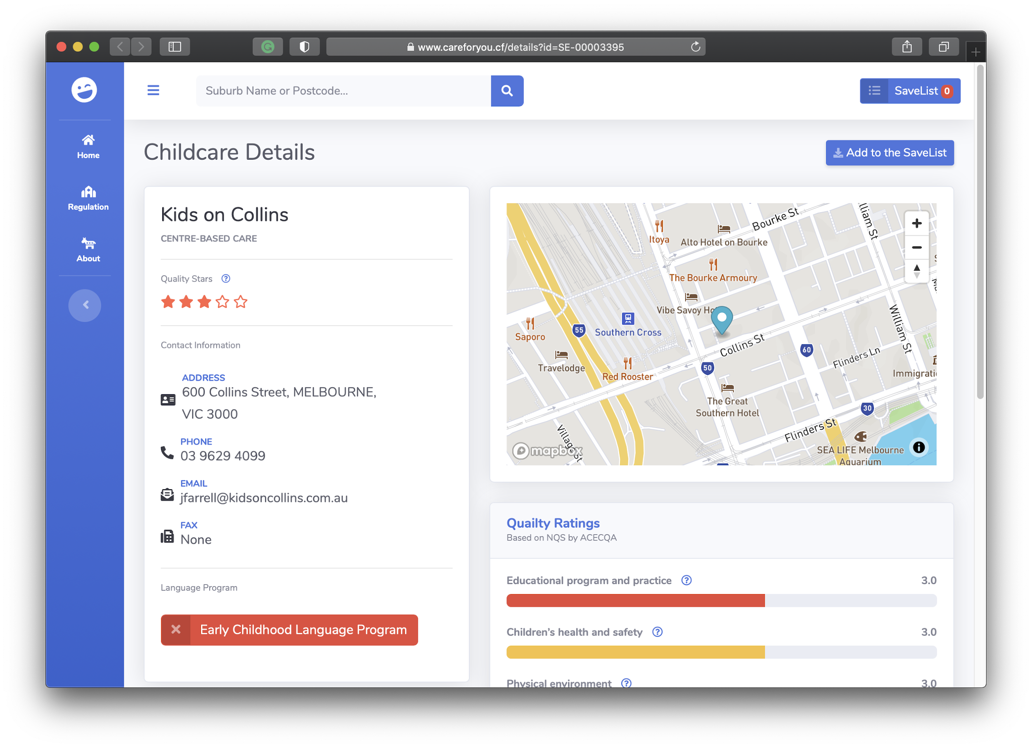
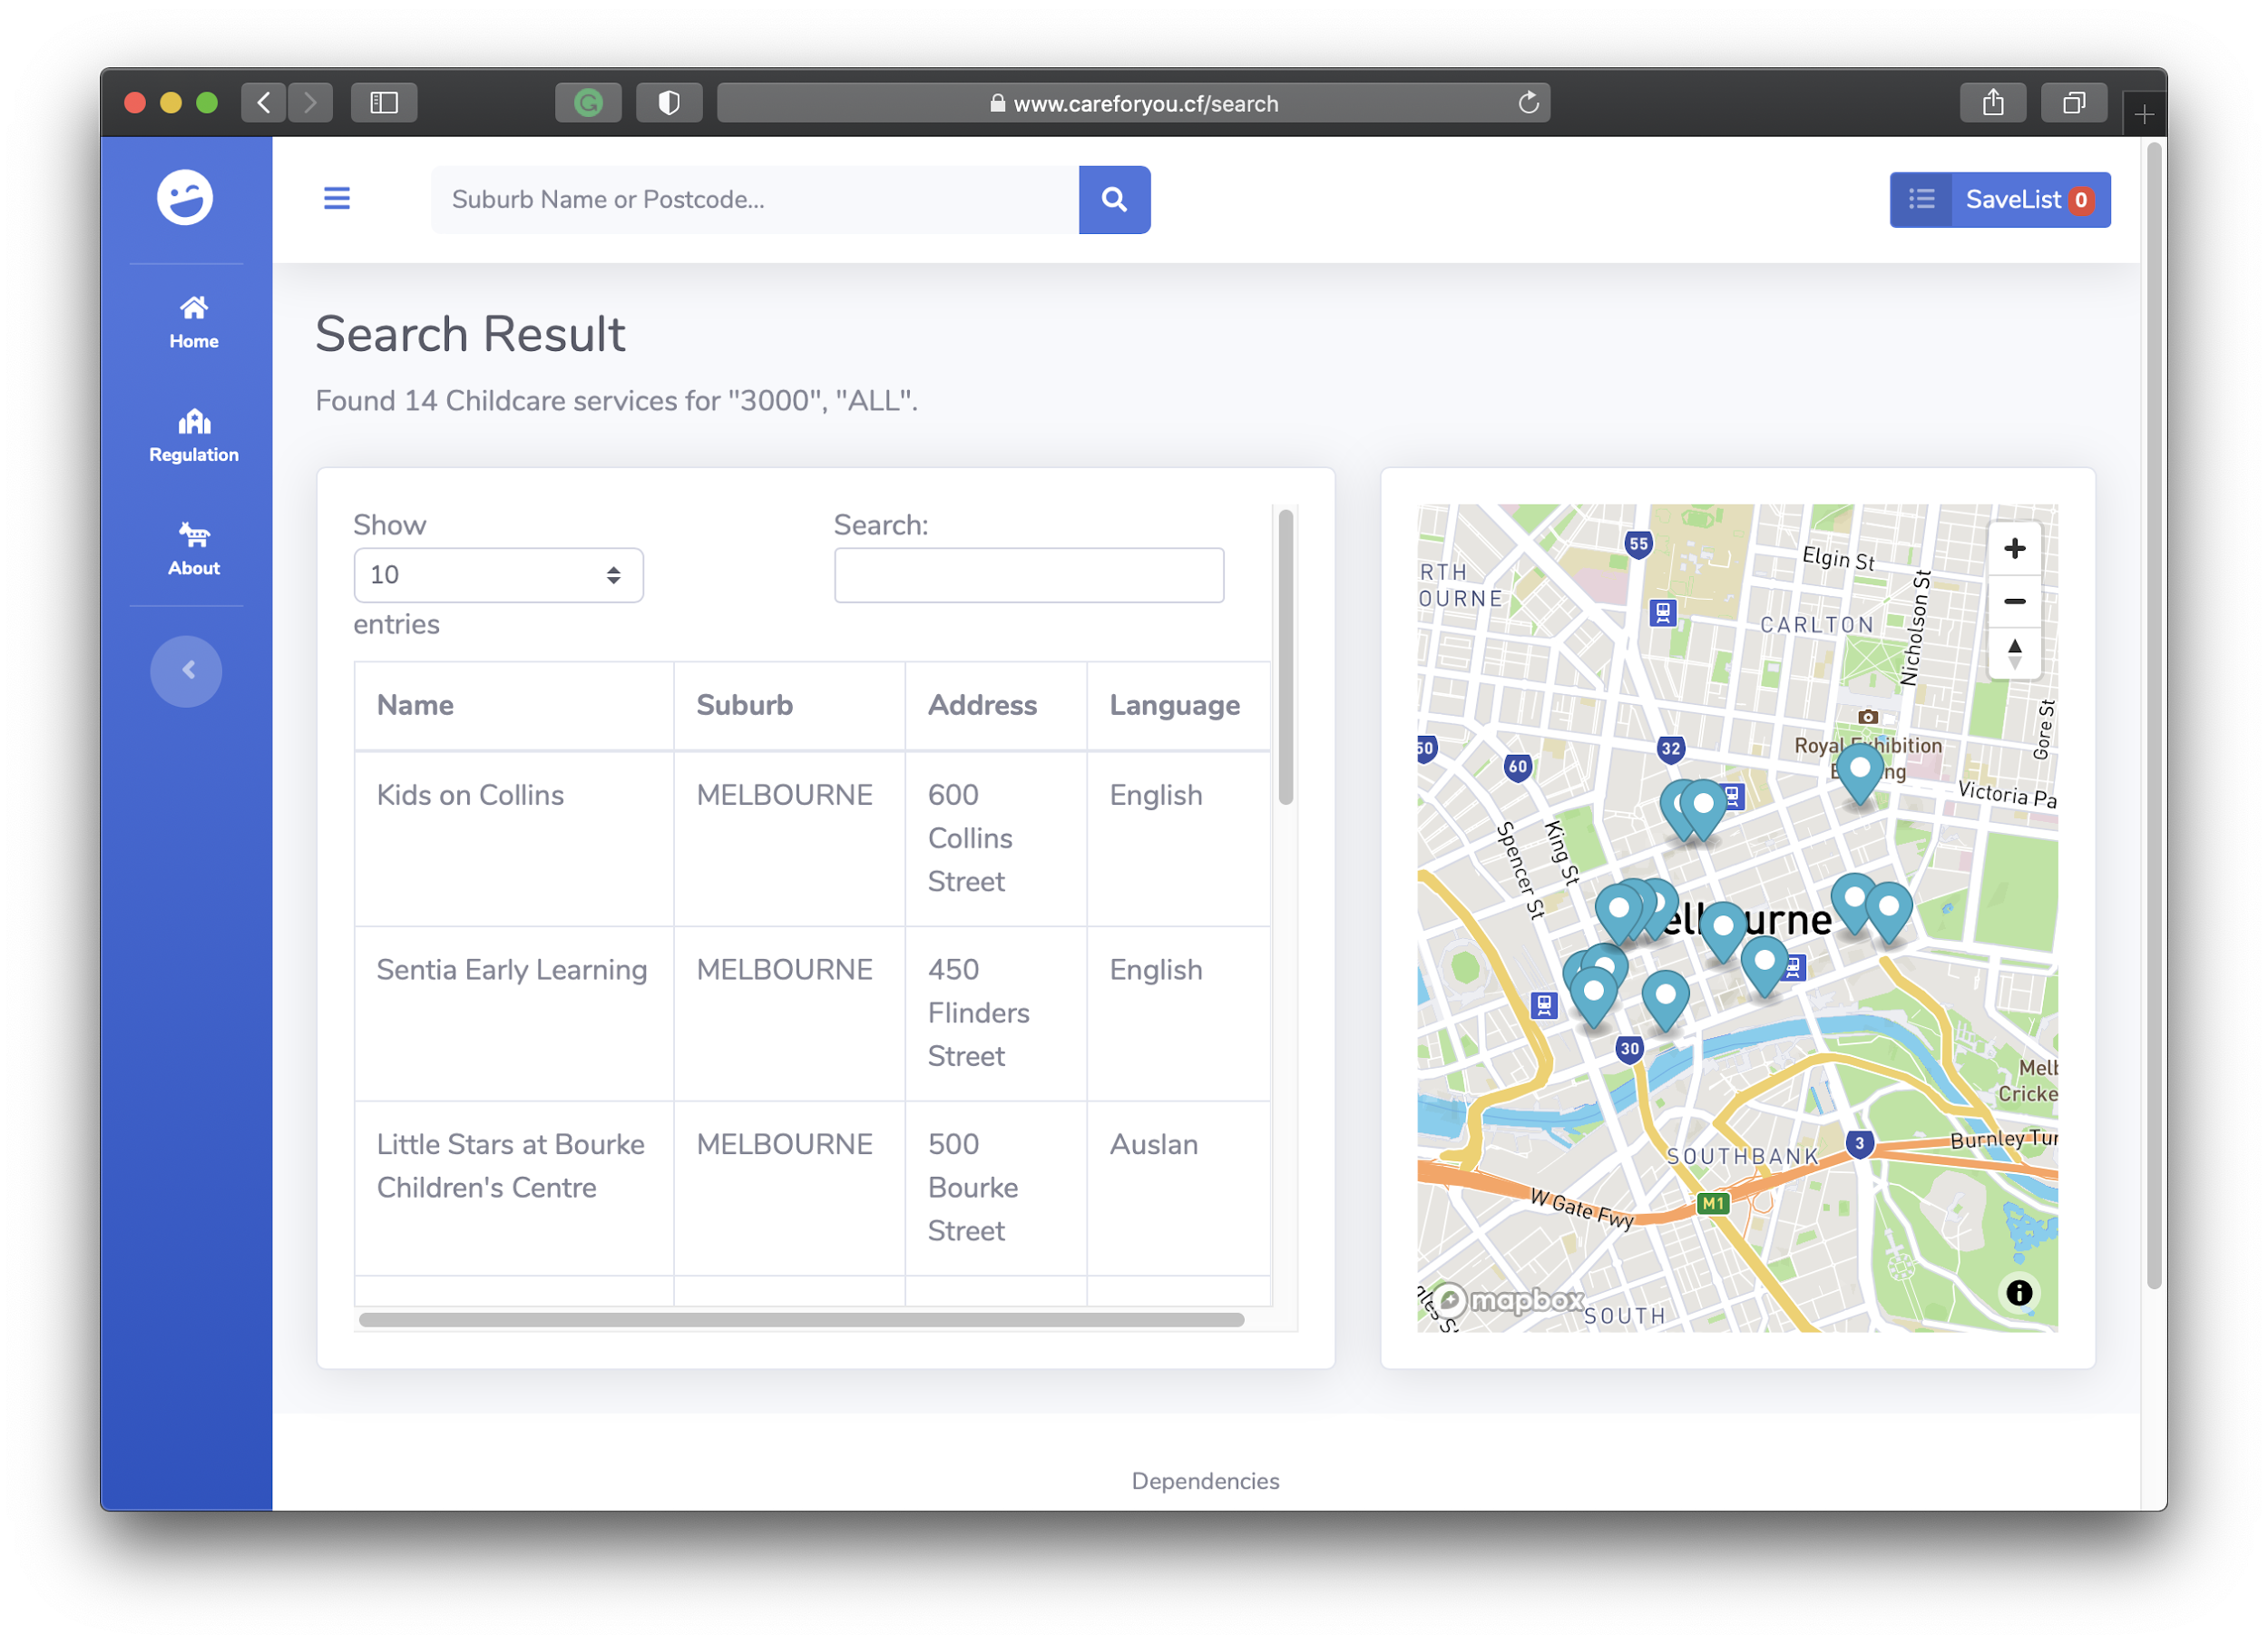
Project Overview
According to the Australian Bureau of Statistics, during the 2011 census it was reported that almost 67% of the recent arrivals to Australia spoke a language other than English at home.
This is a problem faced by many recent immigrant parents, who are working full time and cannot devote enough time to help their kids learn English.
Solution:
Careforyou is a web application focused on helping the non-English speaking, working immigrant parents find bilingual childcare so that they can take good care of their First Generation Australian children and also help them learn English.

Slide 4
Creation of Support Document
Aim
A Guide to day to day operation of the system developed.
Target Audience
Target audience could be system architects, front-end and back-end developers, technical department who wish to operate the system.

Slide 5
Support Document Timeline
Task Name | Start Date | Duration(Hours) | Assigned to | Dependencies
Introduction | 23/10/2020 | 1 | Santosh | Product doc. Task 2
System Structure | 22/10/2020 | 1 | Zhenyu | N/A
Package Structure | 22/10/2020 | 1 | Zhenyu | N/A
Data Details | 23/10/2020 | 2 | Santosh | Product doc. Task 3
Database | 23/10/2020 | 1 | Zhenyu | N/A
System Dependencies | 23/10/2020 | 0.5 | Zhenyu | Product Doc. Task 6
System Setup | 23/10/2020 | 2 | Zhenyu | N/A

Slide 6
Creation of Maintenance Document
Aim
Used by the software maintenance staff to run the product efficiently and extension for future development.
Target Audience
Target audience could be technical staff, database administrators provided with maintenance information.

Slide 7
Maintenance Document Timeline
Task Name | Start Date | Duration(Hours) | Assigned to | Dependencies
Introduction | 23/10/2020 | 1 | Haoqi Xu | N/A
System Environment | 23/10/2020 | 2 | Haoqi Xu | Support doc. Task 2
Data & Database | 23/10/2020 | 2 | Zhenyu | Support doc. Task 4&5
Future Development | 24/10/2020 | 2 | Haoqi Xu | Support Doc. Task 3
System Maintenance Procedures | 24/10/2020 | 3 | Haoqi Xu | N/A
Source code | 24/10/2020 | 1 | Haoqi Xu | N/A

Slide 8
Creation of Product Document
Aim
It should Demonstrate the Target Audience, solution of the product, all the features and functionality of the product and how potential sponsors can take it forward.
Target Audience
Target audience are the potential sponsors or might be anyone who are willing to take up the product.
Potential Sponsors
Government
Primary schools
Childcare Centers
Immigrant Working Parents

Slide 9
Product Document Timeline
Task Name | Start Date | Duration (Hours) | Assigned to | Dependencies
Problem Statement | 23/10/2020 | 1 | Abhinav | N/A
Product Overview | 23/10/2020 | 1 | Abhinav | N/A
Data Source Details | 23/10/2020 | 2 | Santosh | N/A
Security Aspects | 23/10/2020 | 1 | Santosh | N/A
Resources Required | 23/10/2020 | 2 | Abhinav | N/A
Overview of support & Maintenance Documents | 23/10/2020 | 2 | Santosh | Support & Maintenance doc.
Team Description | 23/10/2020 | 1 | Santosh | N/A

Slide 10
CONCLUSION
Deliverables
Final build of system package.
Submit all three document - Support, Product & Maintenance.
Preparing for the final hurdle - EXPO.

Slide 11
Thank You!
Any questions or Feedbacks?

